Slide 1
Mobile Distro Comparisons
An Experiment By Cristian Racila & Nicholas Roy

Slide 2
Project Description/Motivation
Objective: Install Linux distributions on 2 different generations of samsung devices, such as the Galaxy A70(2019) and Galaxy S3(2012) to explore open-source options for older devices.
Motivation: We aimed to enable more users to repurpose older Android devices, contribute to open-source, and share our findings. Additionally, these devices were lying around, unused and laggy, making this a perfect opportunity to expand our Unix class learnings.
Expected Outcome: Produce a step-by-step video tutorial to guide others through the installation process.

Slide 3
Distributions We Considered
-At first, we considered Ubuntu Touch, NixOS, Mobian, Nemo Mobile, PostMarketOS.
-However, what we ended up choosing was Ubuntu Touch, LineageOS, and crDroid for compatibility reasons and available features.
-Why these? Good documentation, community support, and active development .

Slide 4
Code and Documentation (Github)
Unlike source code-based projects, our GitHub repository contains:
Research Notes: Documenting our findings during the exploration of Linux distributions and device compatibility.
Progress Journals: Regular updates on our process, including obstacles encountered and solutions implemented.
Resources Used: A collection of links, guides, and tools that assisted in the project, such as installation guides, TWRP resources, and ROM download links.
Our goal is to share the knowledge gained throughout the project, offering others a resource to replicate or expand on our work.

Slide 5
Development Journey
Planned Steps: Research, finalize distributions, create video tutorials.
Actual Experience:
Challenges with both phones delaying our progress (a LOT).
Adjustments to TWRP flashing techniques.
Time spent troubleshooting unexpected errors (infinite).
Lessons learned: Importance of device-specific research and backups.

Slide 6
S3 Initial Plan
Research lead us to postmarketOS for our main candidate:
1. SD card partitioning:
Configure the SD with all the necessary partitions. One for boot, system, etc...
2. Flash image files:
Use the files from postmarketOS site to flash to their respective partitions.
3. Boot from SD card:
Simply load into the phone, and boot. Easy...?

Slide 7
What I learned through experience
What I learned through confusing steps, little documentation.
No single source provided a working solution for my specific case.
Trial 1 - Heimdall with Linux
Knowledge of PIT files and how they are used to flash mobile devices
Using download mode for installing ROMs without TWRP
Heimdall as a tool to manipulate mobile devices
Trial 2 - Flashing an SD with ODIN
First use of ODIN utility, using a device connection to transfer files
Trial 3 - Using pmboostrap
Involved in the configuration of a PM distribution with terminal

Slide 8

Challenges I Faced With The S3
With the little documentation available, it can be easy to make
a fatal error when the solution calls for a detour in plans. I found
that one simple oversight in the beginning can lead to an unexplainable
error further down the line.
This is already an invasive process, meaning it is NOT user friendly.
I struggled with:
Attempting to install straight from heimdall, which is too broad and does not support specific device cases
Trying to have the SD read from TWRP menu to boot from there like a flash drive
pmbootstrap initialization simply not able to install a stable version
Needing to give up on postmarketOS entirely, to switch to crDroid
You must learn to deal with the fear of bricking your phone : (

Slide 9
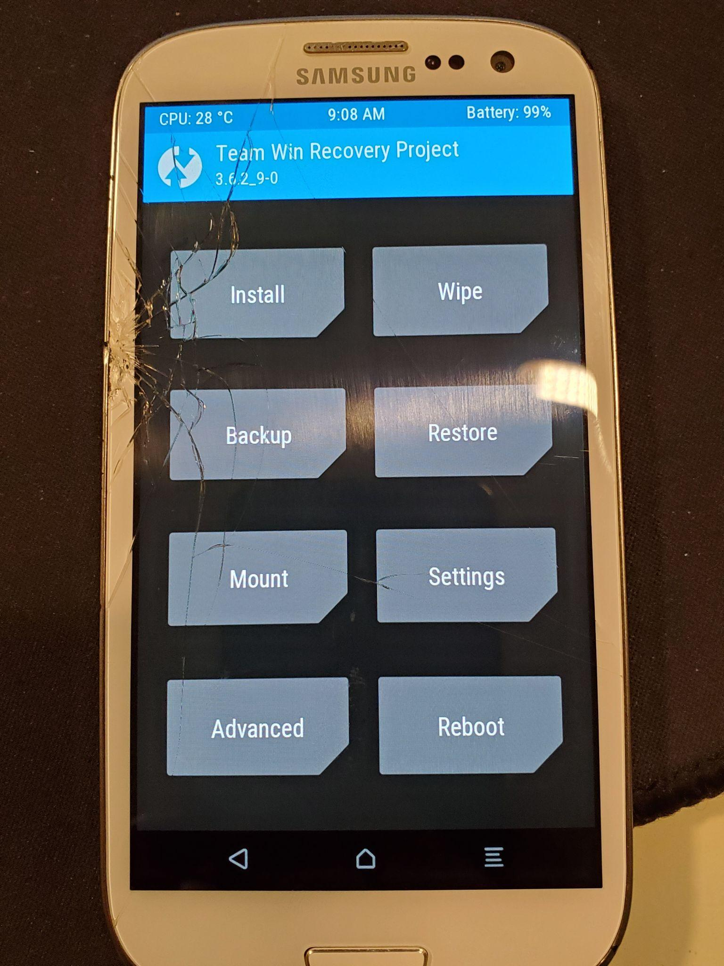
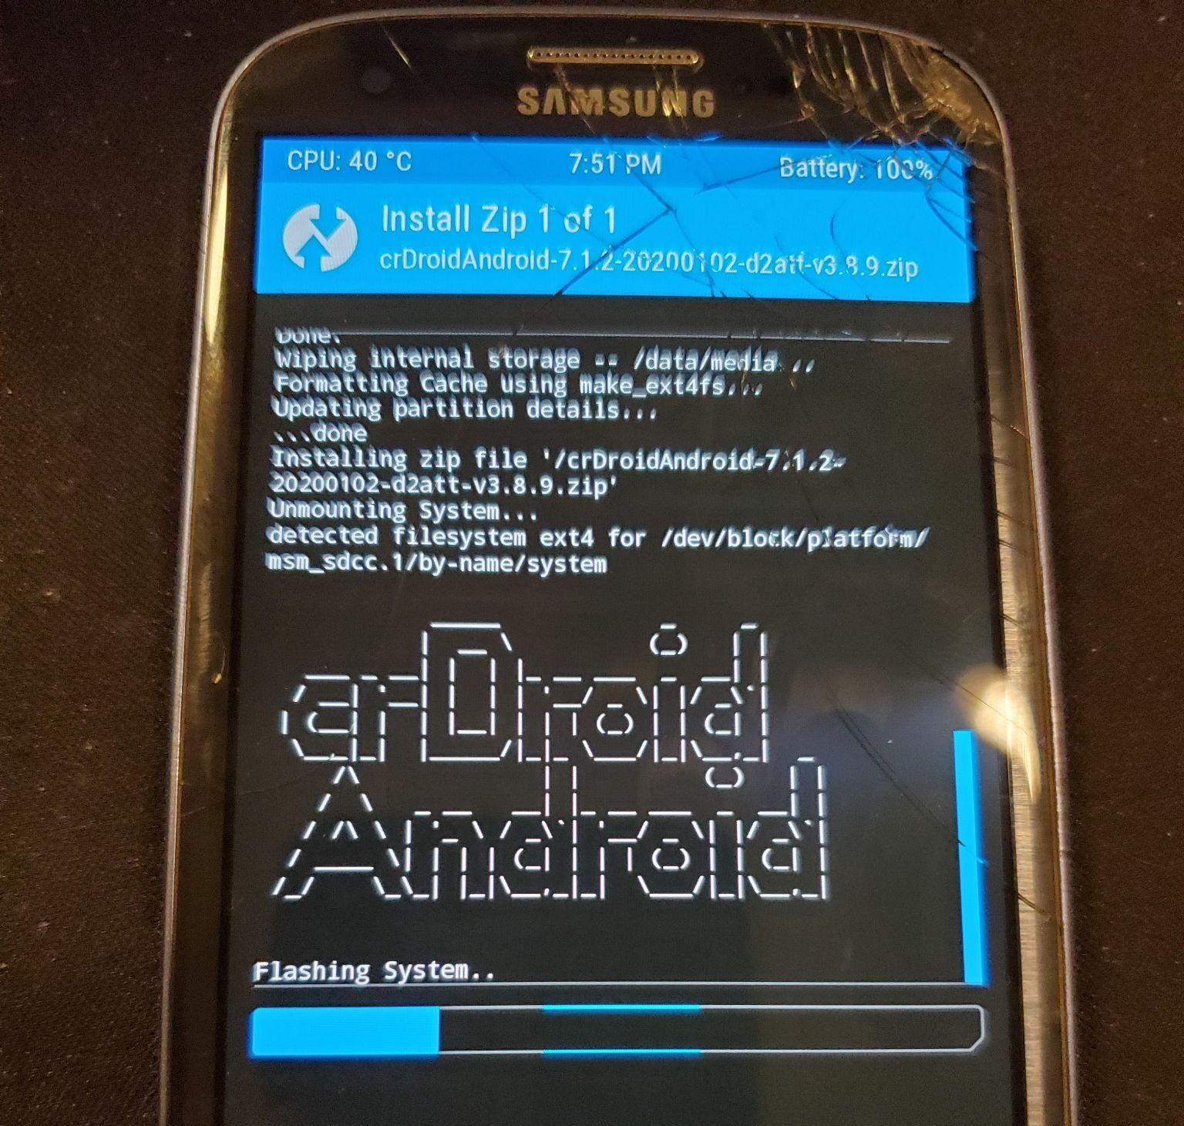
Team Win Recovery Project (TWRP)
A useful software that can be accessed through most android’s recovery mode.
Allows useful manipulations such as:
Booting/installing from a zip file
Creating backups
Terminal access
A necessity for all custom ROM installs
Allowed our project to be possible

Slide 10
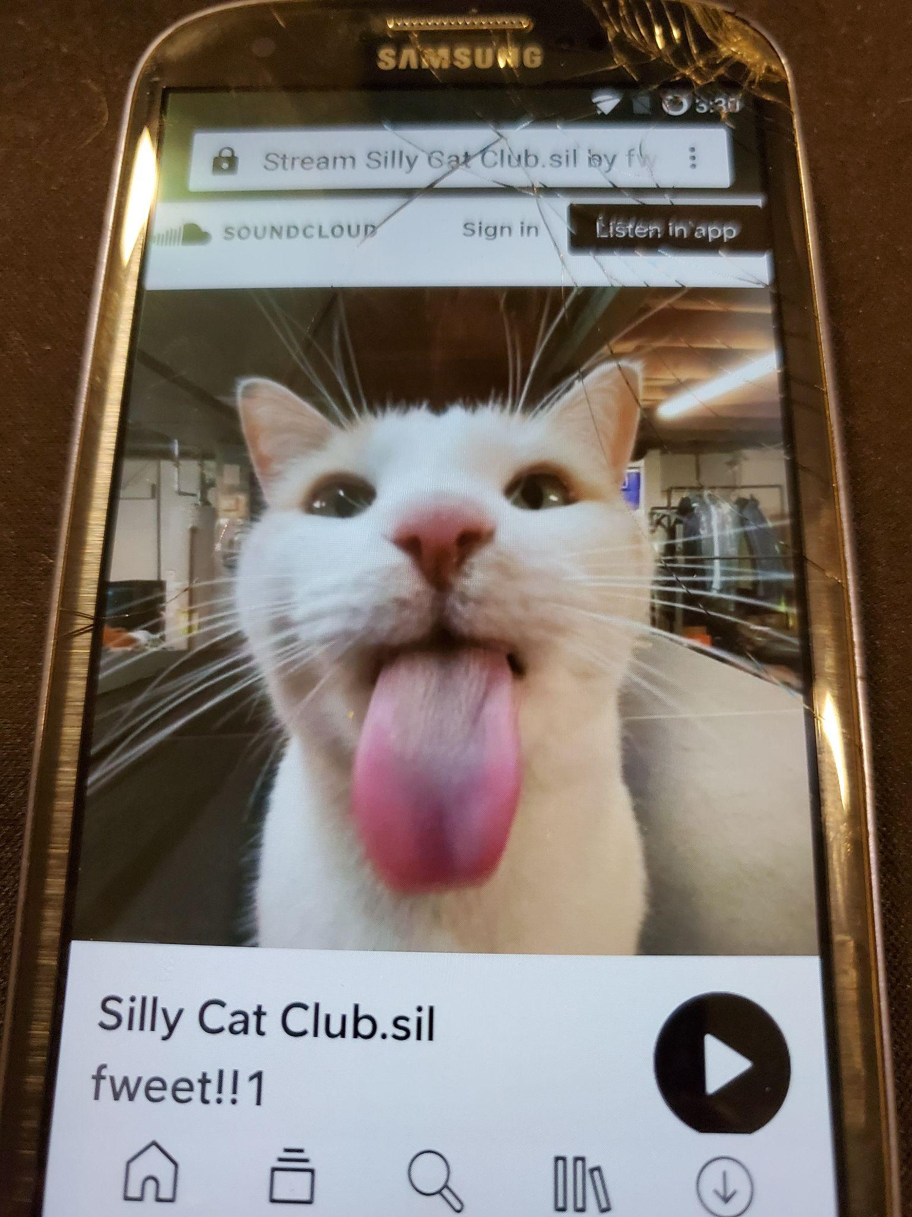
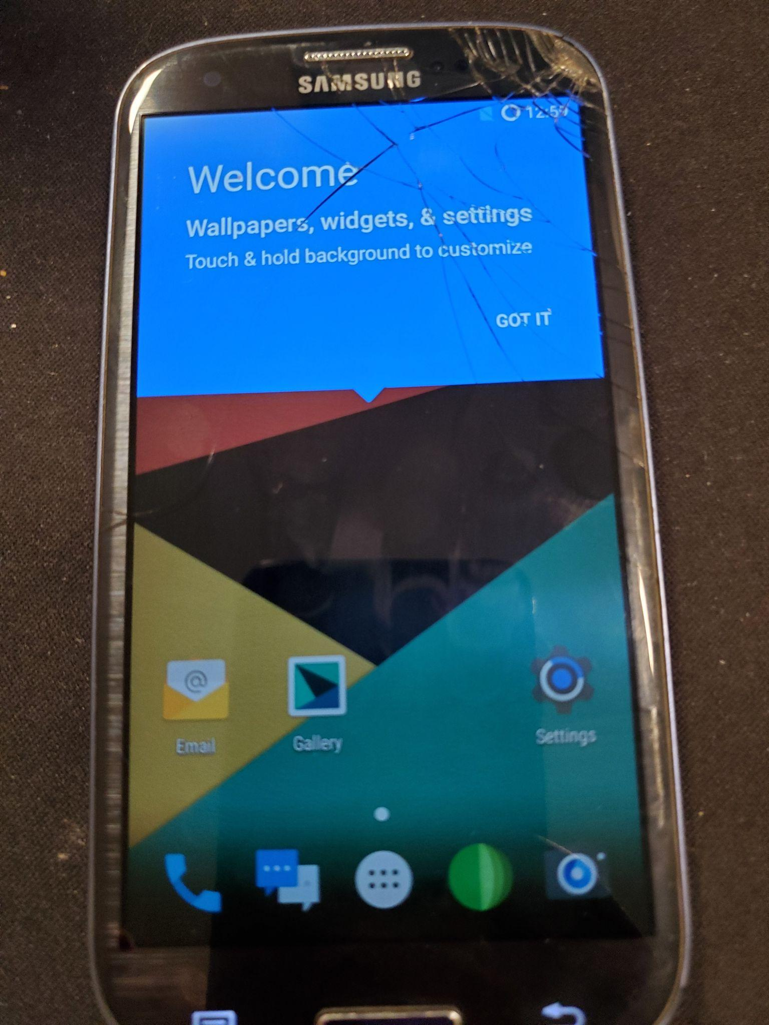
How To Successfully Install
The solution was simple, but required specific steps.
This process includes installing a single zip file with a distribution from the web. In my case on that is samsung s3 specific.
Make sure to install TWRP to access the zip with boot configurations
In TWRP menu, wipe your phone clean
In PowerShell, run ./adb push "file.zip" / to download the file onto your phone
Install the file through TWRP, reboot
I initially wanted to stick to a single distro to gain a fuller understanding, but somehow failure brought me to a version that I’ve never even heard of before.

Slide 11


What I Achieved
By the end, I came up with a replicable solution to this
great problem of ours.
Gained hands on experience for similar ROM/mobile distro related scenarios
A working distribution of crDroid on a mobile device
A detailed user-friendly guide describing the steps needed to accomplish this task
An understanding of how different android models can very in solutions for custom ROMs

Slide 12
A70 Initial Plan
The goal for the Samsung Galaxy A70 was to try out two specific Linux-based distributions—Ubuntu Touch and LineageOS 17.1—to see if they could successfully run on the device.
Steps:
Flash TWRP with Odin (since I used Windows): Use Odin to flash the TWRP recovery on the A70, which is crucial for the installation process.
Once TWRP is installed, perform a factory reset and format the device to ensure a clean installation environment.
Using ADB (Android Debug Bridge), I transferred the necessary ZIP files (Ubuntu Touch or LineageOS) to the device.
Install the ROM Using TWRP: Through the TWRP recovery interface, install the transferred ZIP file and reboot the device.
Goal: Install Ubuntu Touch and LineageOS 17.1 on the Galaxy A70 and document the process for others to follow.

Slide 13
Challenges I Faced With The A70
1. Finding Correct Installations of Odin and TWRP
The first challenge was ensuring I had the correct versions of Odin and TWRP for the Samsung Galaxy A70. Using the wrong versions can cause installation failures or device issues.
2. Getting Familiar with the Button Combinations to Open Recovery Mode
Samsung devices have specific button combinations to enter recovery mode. Figuring out the correct sequence (Power + Volume Up + Bixby) took some trial and error, as it wasn't immediately obvious for the A70. For instance, if I didn’t boot in recovery fast enough after installing TWRP, the system would wipe it and I would have to restart the process.

Slide 14

Challenges I Faced With The A70 (Part 2)
3. Biggest Challenge: Fixing the VBMeta Error
The VBMeta error was the biggest issue. This error appears during the flashing process, usually due to the system not recognizing a modified boot image. It was an unexpected challenge but required us to patch the VBMeta image and reflash it to the device. Once done, it resolved the issue. (How?)
4. Why VBMeta Error Happened and What It Means
The VBMeta error occurs when the device's security settings don’t match the new custom ROM being installed. It’s tied to Google’s Verified Boot, which ensures the integrity of the device’s firmware. Custom ROMs often break this chain, triggering the error. To fix this, we needed to disable verified boot with a patched VBMeta image. Basically redflags when notices it’s not samsung.

Slide 15

Updated Steps
Install Odin and TWRP
Flash TWRP via Odin
Reboot into TWRP recovery
Factory reset and format
Push ROM via ADB
Patch and flash VBMeta image
Install ROM zip in TWRP
Reboot to system
Youtube Tutorial On The Flashing Once You Have TWRP

Slide 16
What I Achieved With The A70
-Successfully installed Ubuntu Touch, LineageOS, and crDroid on the Galaxy A70.
-Created a detailed, beginner-friendly YouTube tutorial featuring all three installs, excluding installing TWRP.
-Contributed to the open-source community by documenting the process.
-Gained hands-on experience with flashing and debugging tools.

Slide 17
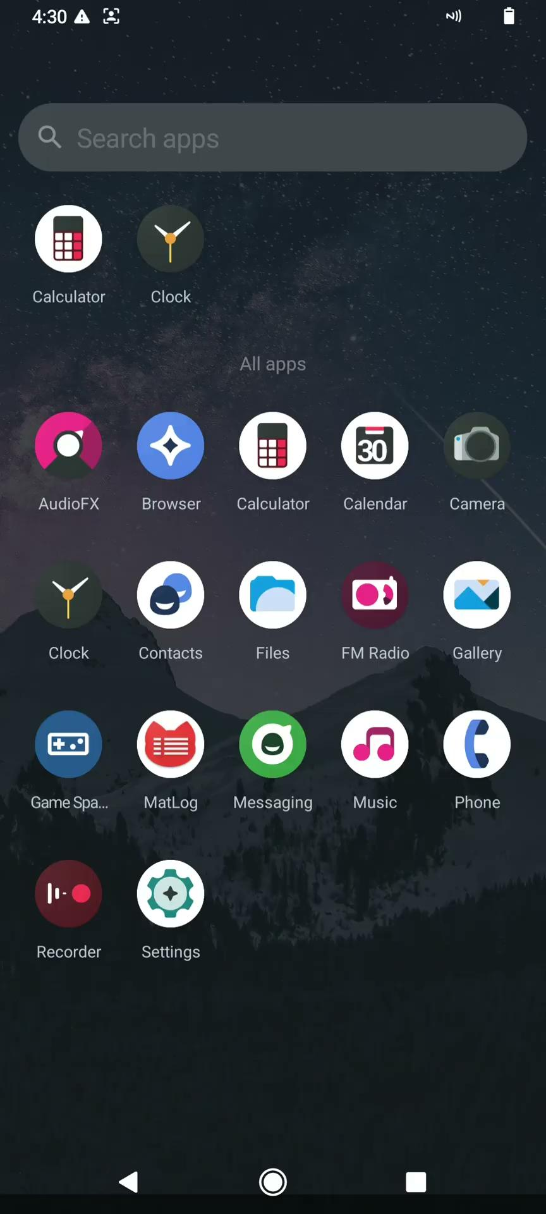
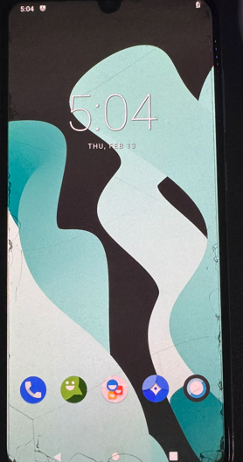
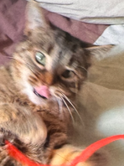
Distributions’ Features On The A70 - UI
Cr Droid
LineageOS

Slide 18
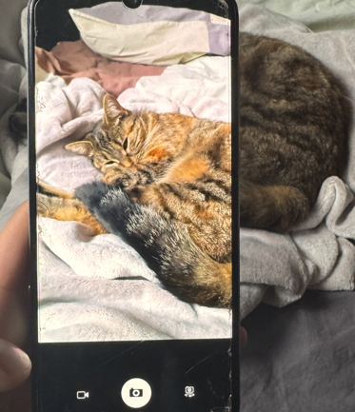
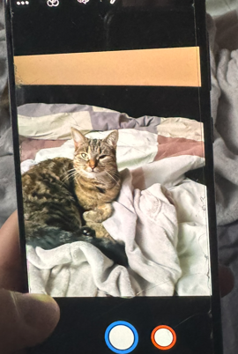
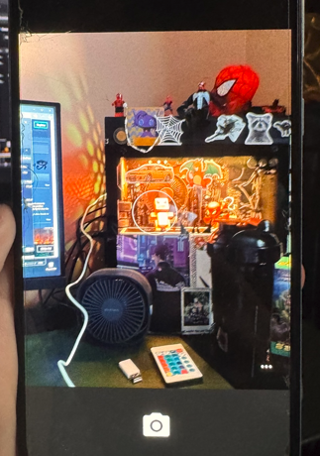
Distributions’ Features On The A70 - Camera
Ubuntu Touch
LineageOS
Cr Droid

Slide 19
What’s Next ? (Future plans)
Contribute findings to XDA and GitHub to help others troubleshoot.
Engage with open-source projects for Linux on mobile platforms.

Slide 20
Demo
Our Contribution
Feel free to take a look at the devices as they pass around.
The A70 currently has Ubuntu Touch on it, and the S111 Cr Droid. (Careful with S111 pls).
Shared our process and fixes for uncommon errors.
Uploaded scripts and installation notes to GitHub.

